Slide 1


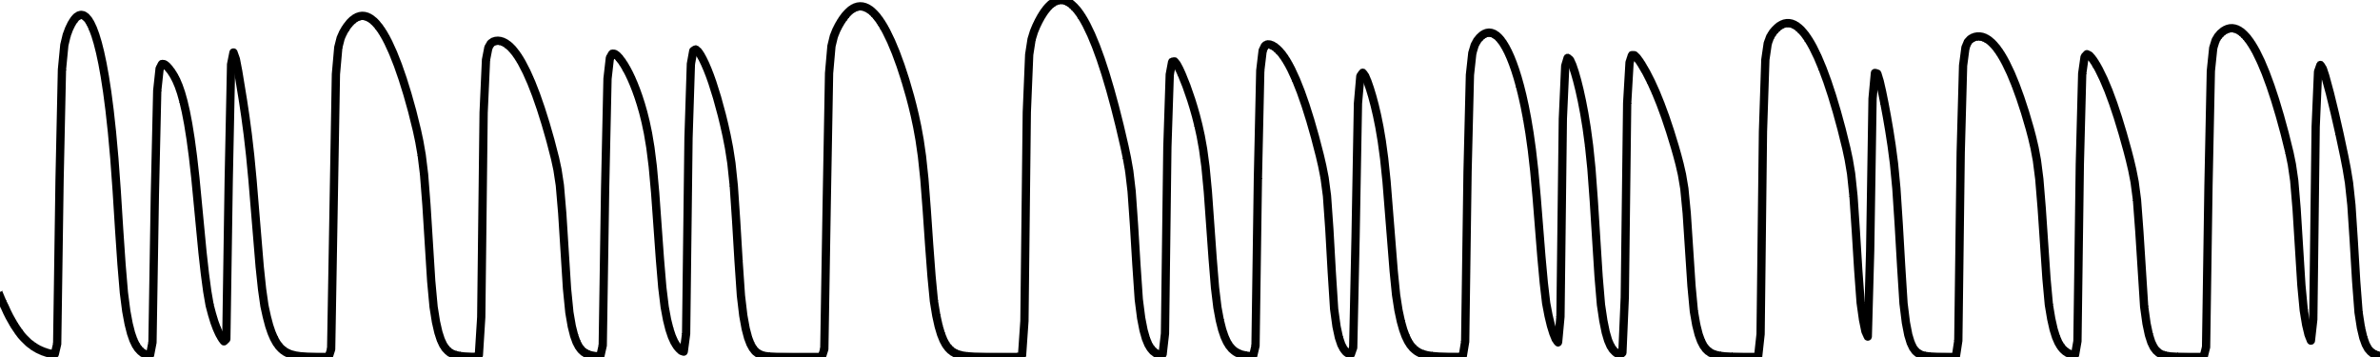
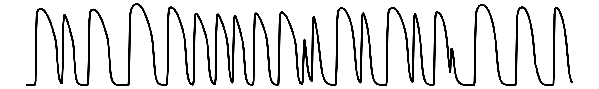

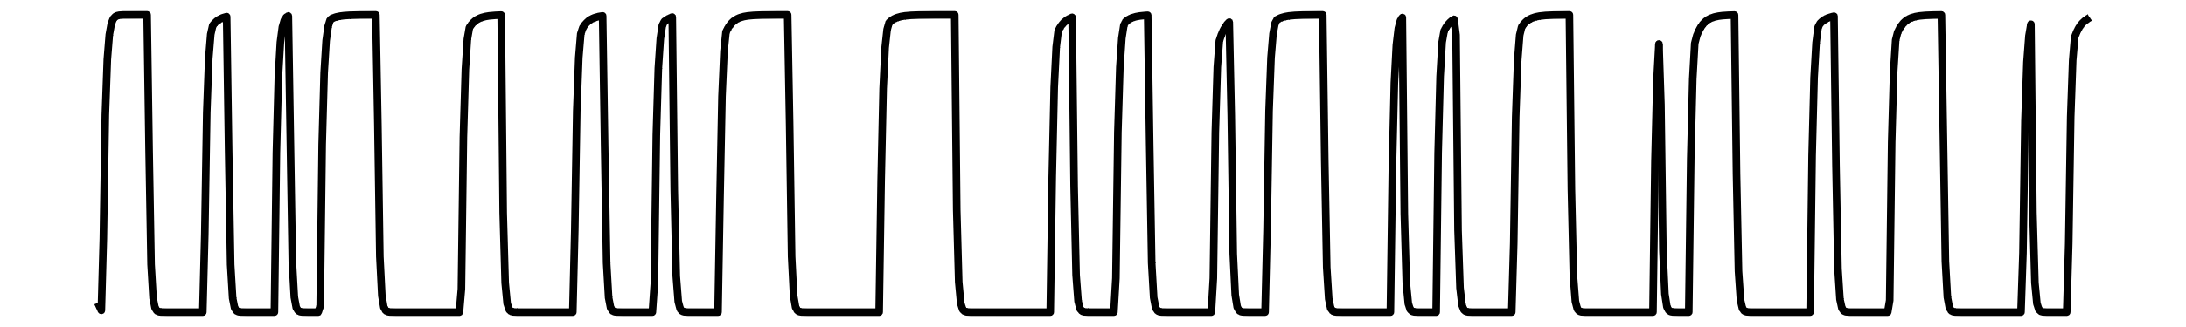
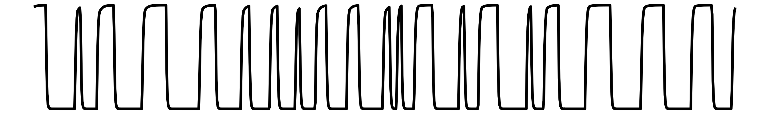
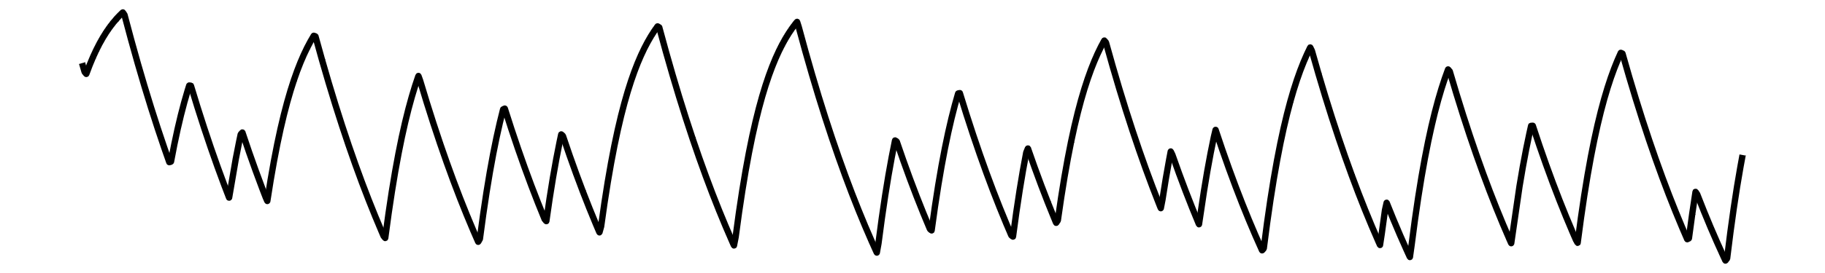
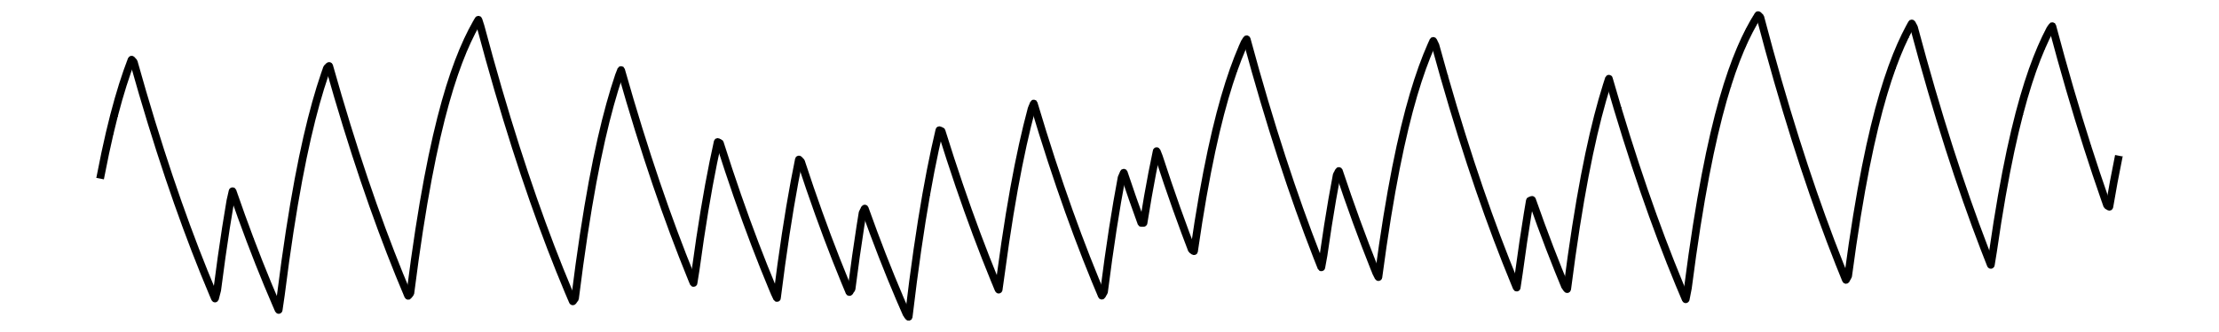
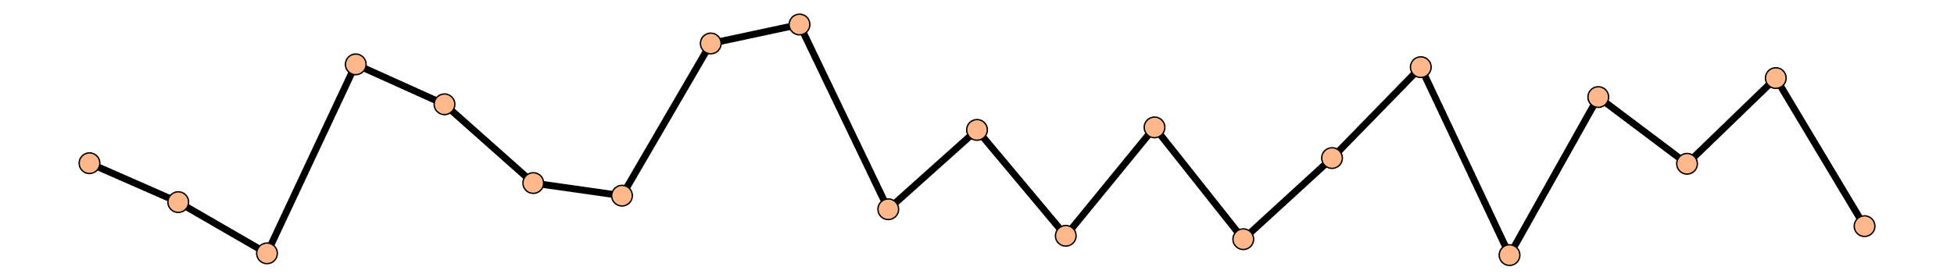
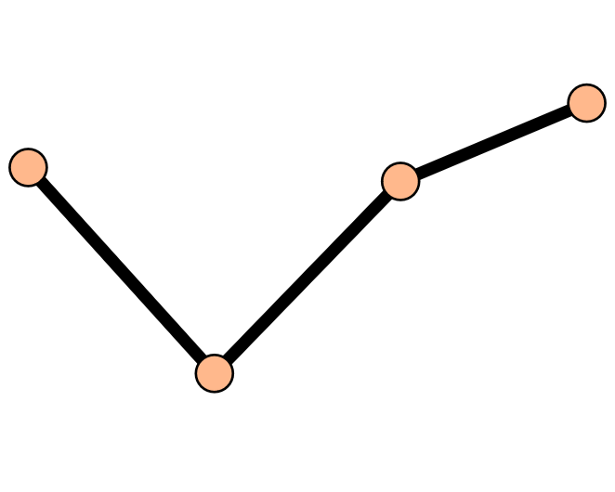
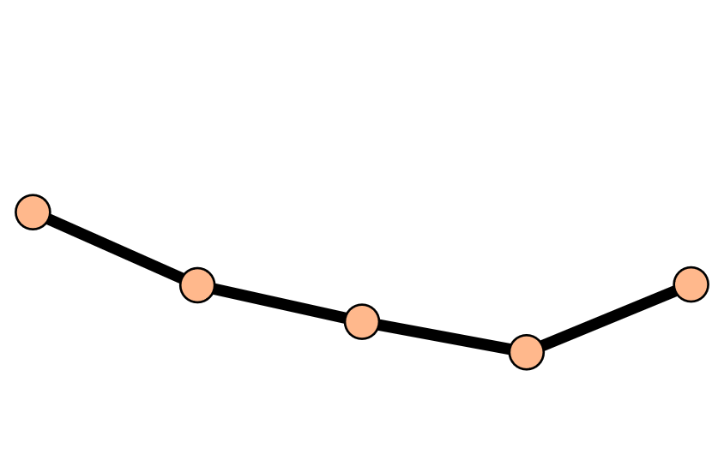
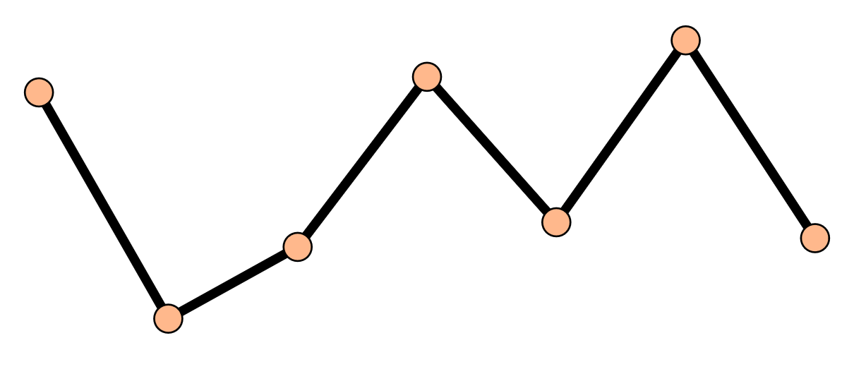
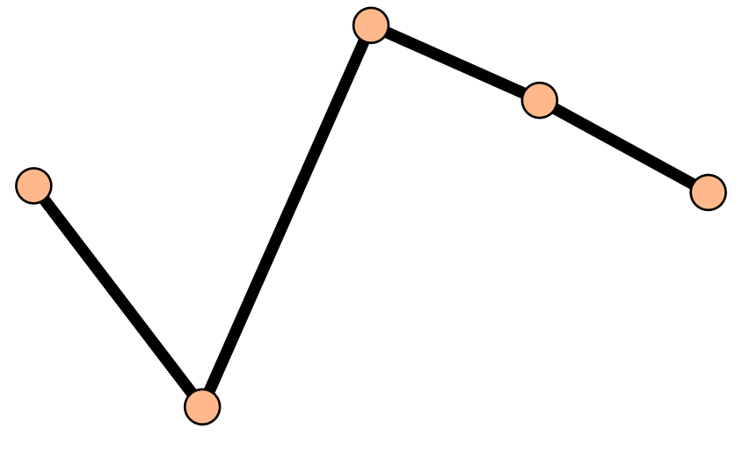


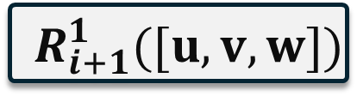



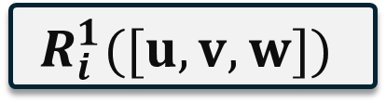




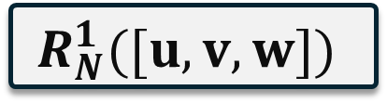

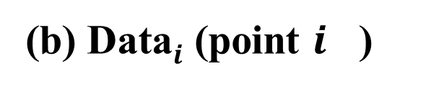


(a) Simulation
(b) Data$i$ (point $i$ )
$$i$$
Voltage(u)
● ● ●
● ● ●
● ● ●
● ● ●
● ● ●
v
● ● ●
● ● ●
● ● ●
● ● ●
● ● ●
w
● ● ●
● ● ●
● ● ●
● ● ●
● ● ●
APD
● ● ●
● ● ●
● ● ●
● ● ●
● ● ●
Time step
0
Transient
52e4
$$R_{i}^{1}$$
$$R_{i}^{2}$$
$$R_{i}^{3}$$
$$R_{i}^{4}$$
$$R_{i}^{5}$$
183e4
(c) Lyapunov Exponent Calculator
$$R_{i}^{1}([u,v,w])$$
TLE
$${LE}_{i}^{1}$$
AVG
$$LE^{1}$$
AVG
$$LE(uvw)$$
$${ R}_{i+1}^{1}([u,v,w])$$
TLE
$${ LE}_{i+1}^{1}$$
● ● ●
$$LE^{5}$$
● ● ●
● ● ●
● ● ●
$$R_{N}^{1}([u,v,w])$$
TLE
$${LE}_{N}^{1}$$

